Slide 1
ReasonED:
Formal Demo
Team Crystal
Emily Louk
Alysha Morgan
Areeb Nabi
June Troyer
Dakota Dawe
Nolan Marchione
Daniel Cielinski
CS 411W Professional Workforce Development ⅠI
04/16/24

Slide 2

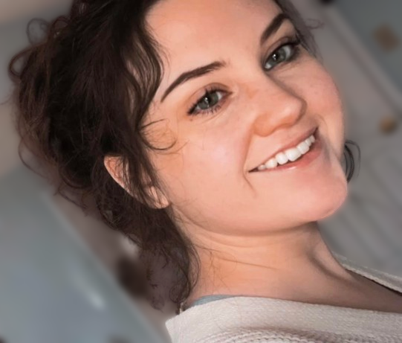
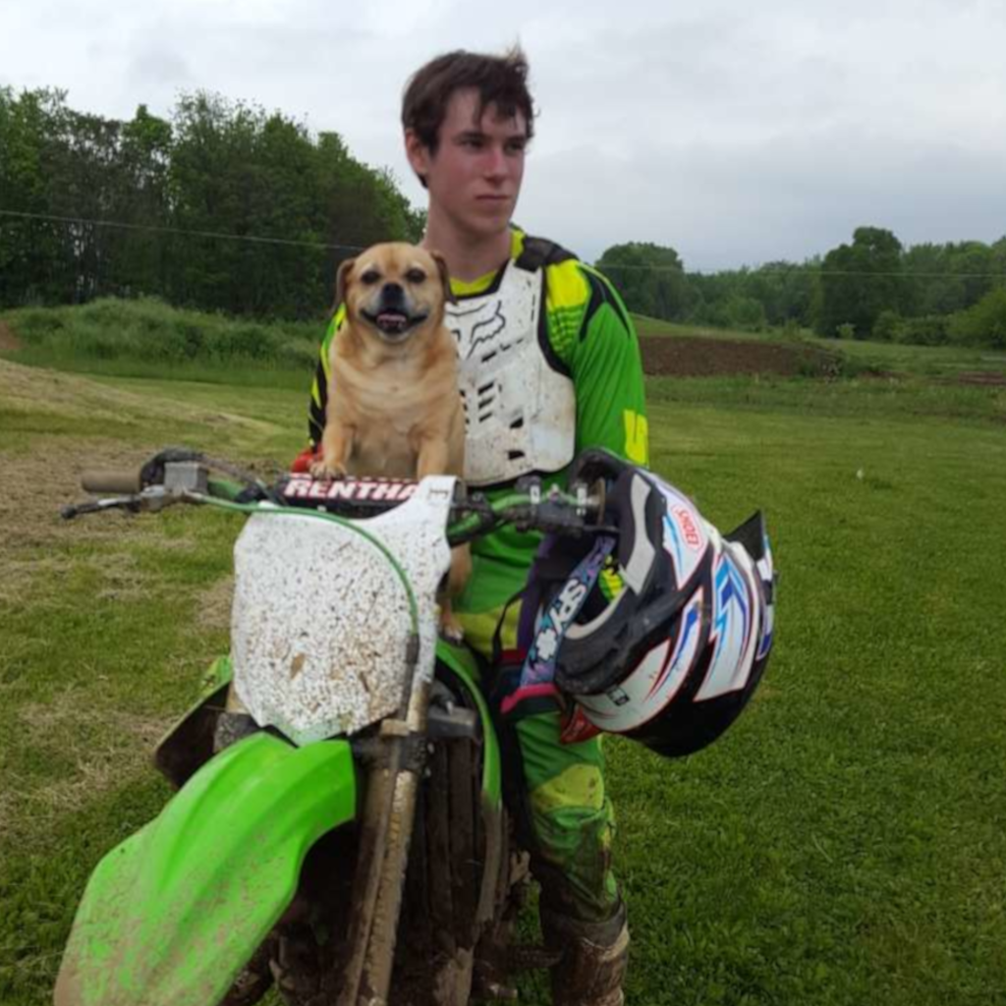
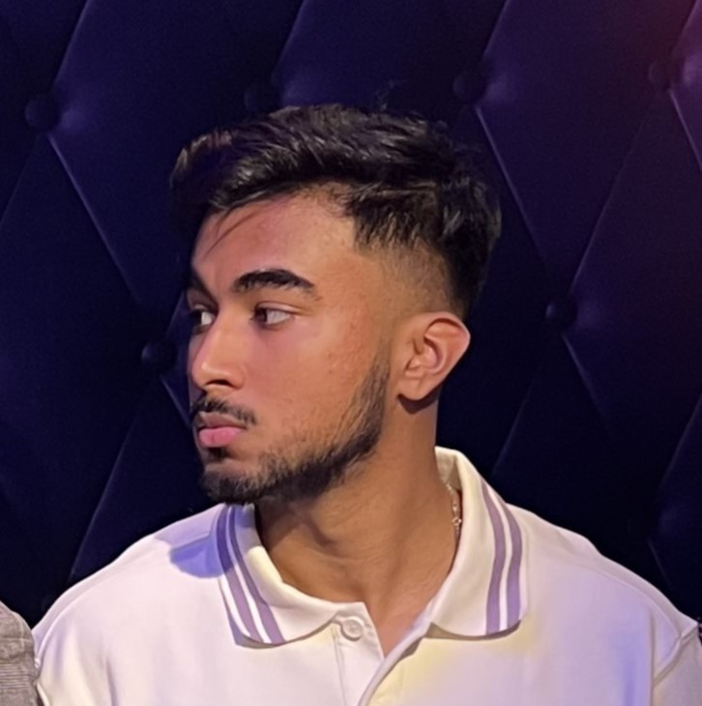
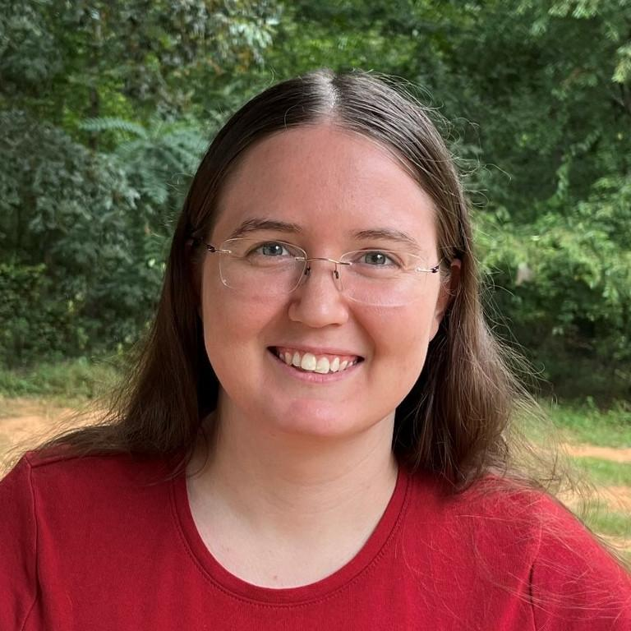
Biographies
Emily Louk
Dakota Dawe
Areeb Nabi
June Troyer
Emily is a senior undergraduate at ODU. She has an Associate degree in Information Systems and will pursue software engineering after earning her B.S.C.S.. At ODU, she has interned with the Game Studies program as a programmer and participated in a research project. She is interested in developing educational tools, video games, and mobile apps.
Dakota is still finishing his Associates degree at LFCC while working through the remaining courses at ODU for his Bachelors. Dakota is currently working as a games programmer selling plugins on the Unreal Engine marketplace as well as a contract programmer for Small Indie Company developing their upcoming title “We The People”.
Areeb is a senior at Old Dominion University pursuing his undergraduate degree in Computer Science. He recently completed a 10-week summer internship with Automatic Data Processing (ADP), honing his skills as a Full-Stack Developer. Areeb specifically enjoys front-end development, and working with JavaScript libraries such as React, Express, and Node.js.
June is a senior Computer Science undergraduate at ODU in the linked Master’s program. She has an associate degree in Science from Piedmont Virginia Community College. She enjoys helping others explore new topics and improve their skills and reasoning.
CS 411W
ReasonED | Formal Demo
Notes:
Before we dive in we'll take a quick minute to introduce ourselves. [Each member will briefly introduce themselves]

Slide 3
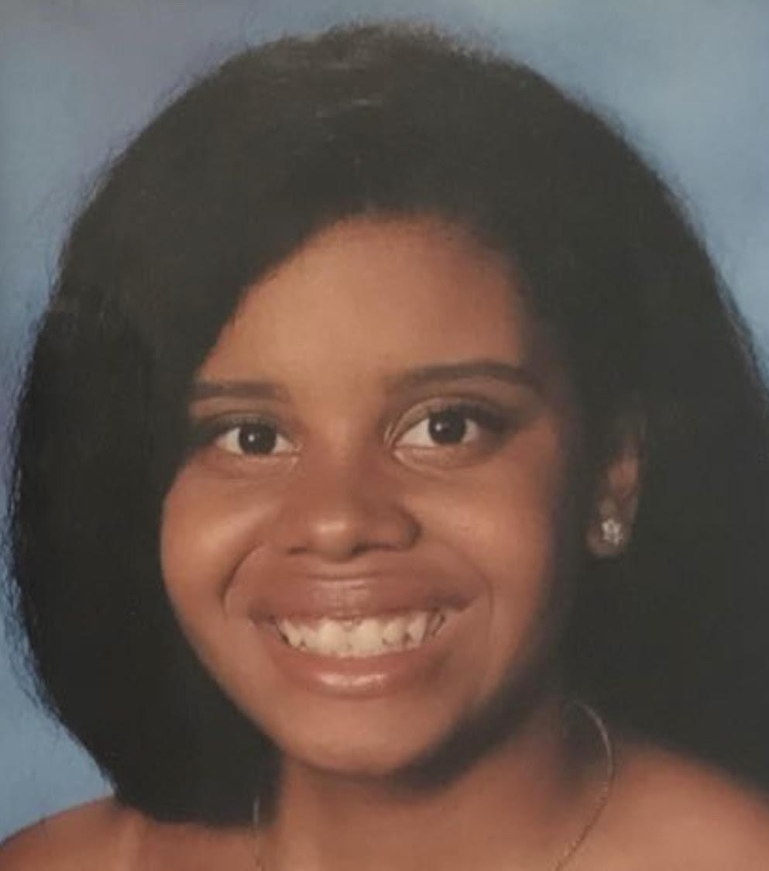
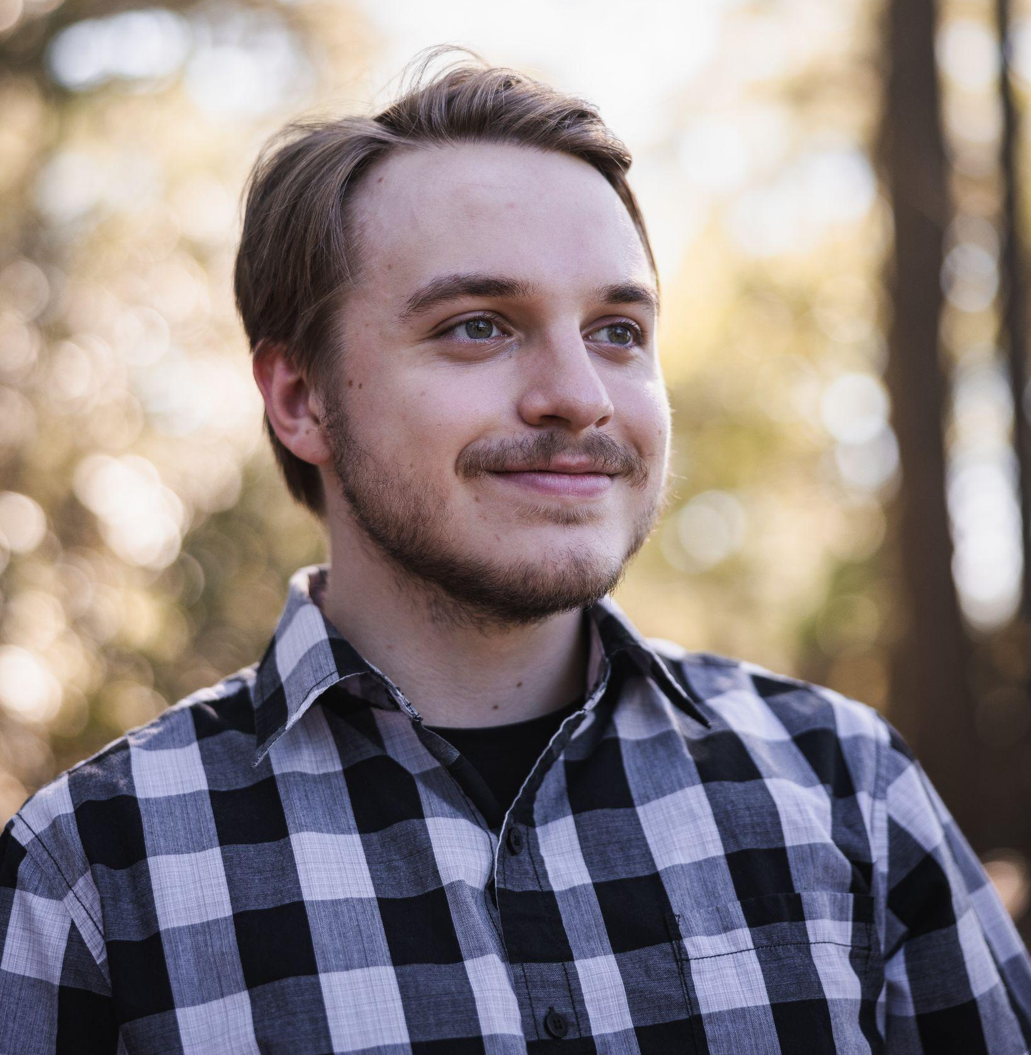
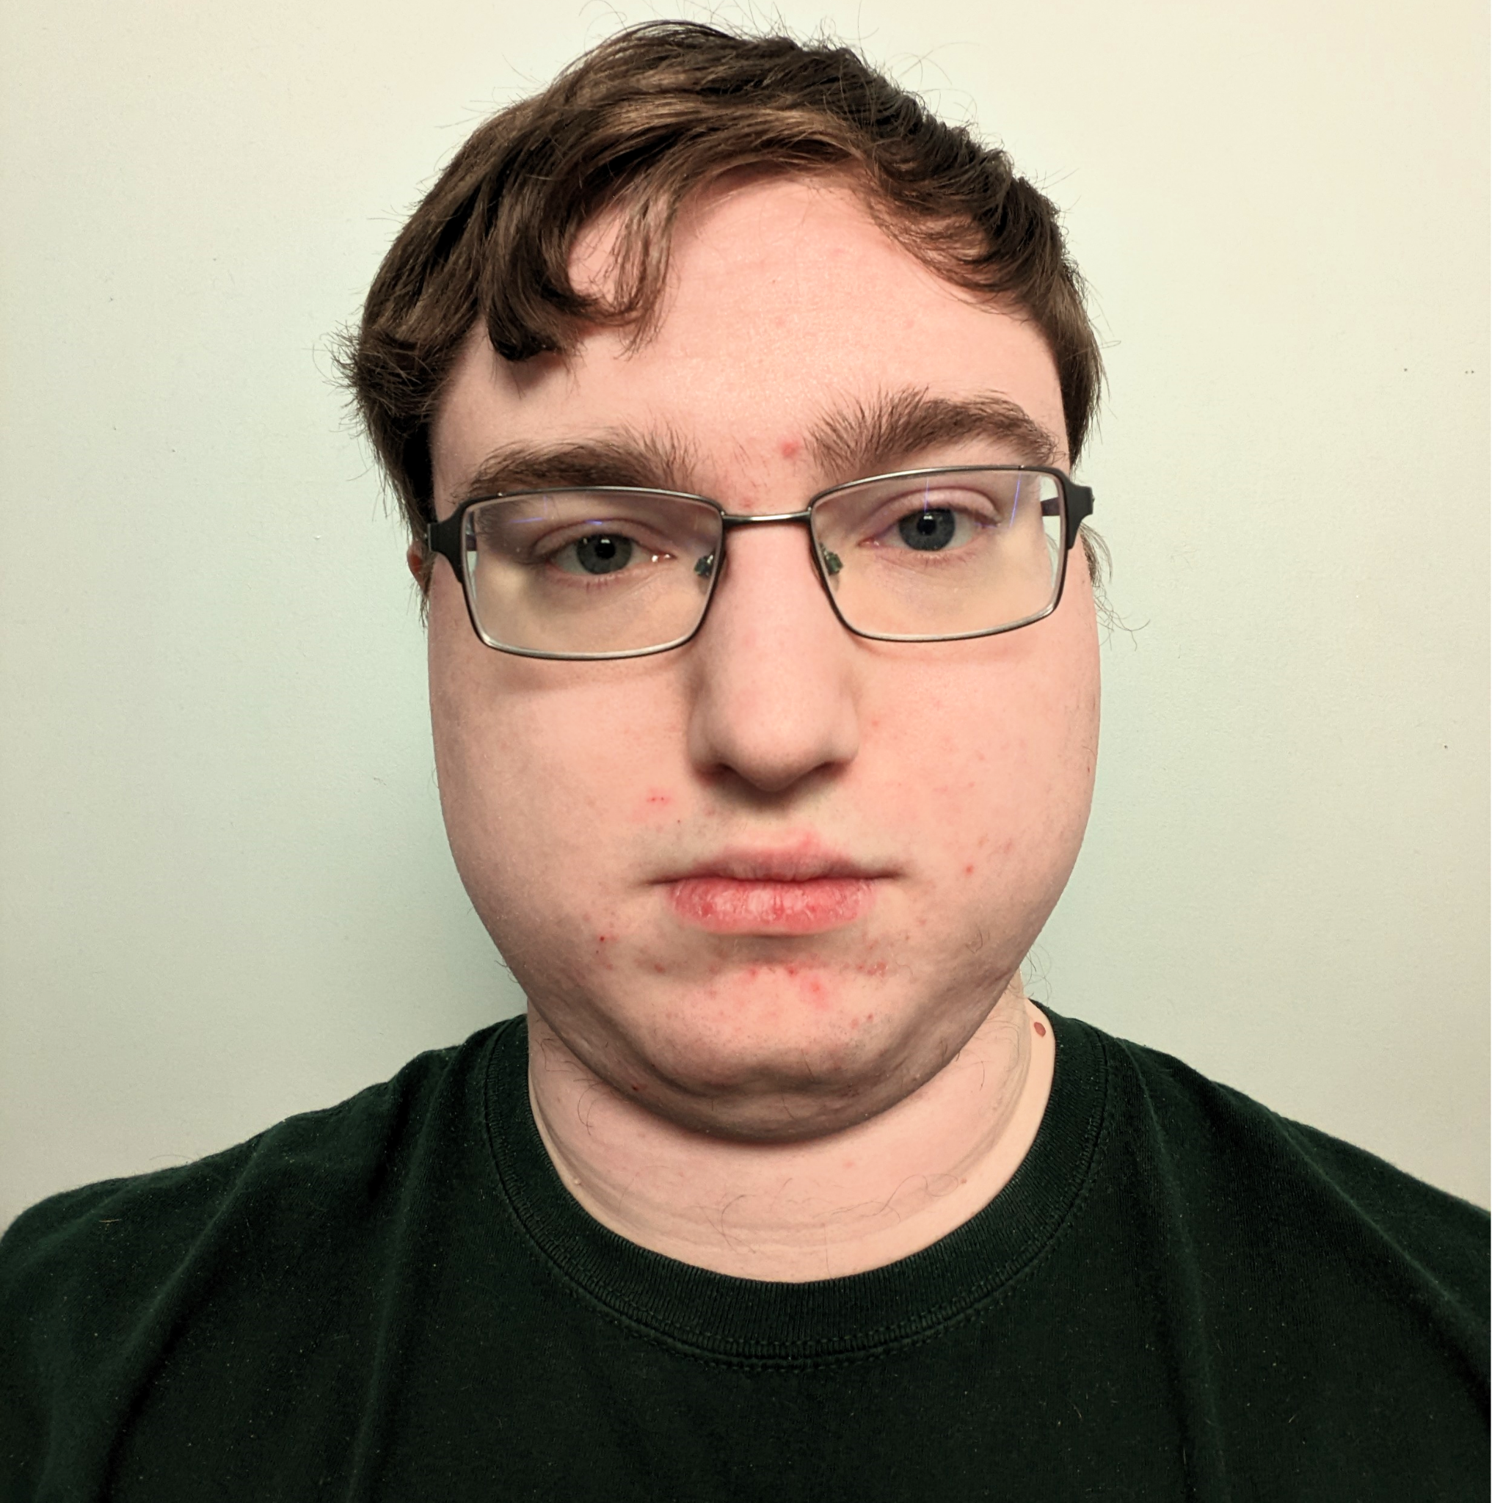
Biographies cont.
Alysha Morgan
Nolan Marchione
Daniel Cieslinski
Alysha is a undergraduate Senior at Old Dominion University, currently working towards her Bachelor’s degree in Computer Science with a minor in Cybersecurity. With a deep passion for technology, she is actively honing her skills to become a software engineer.
Nolan is an undergraduate senior at Old Dominion University, aiming for a Bachelor’s degree in Computer Science. He enjoys listening to music, and is interested in using his skills to develop video games and open-source software tools.
Daniel is a senior at ODU and is pursuing a bachelor's degree in CS. He had previously obtained an associate's degree of Engineering at TNCC (now VPCC) and had also worked at NVIDIA for an internship. In his free time, he enjoys fighting games, MMOs, and tabletop games.
CS 411W
ReasonED | Formal Demo
Notes:
[Each member will briefly introduce themselves]

Slide 4
Problem Solution
High school graduates are not prepared with the skills necessary to identify logical fallacies in an increasingly online world.
Game-based learning website that improves the ability of users to identify logical fallacies through engaging, age-appropriate video games.
CS 411W
ReasonED | Formal Demo
Notes:
In case we need it

Slide 5
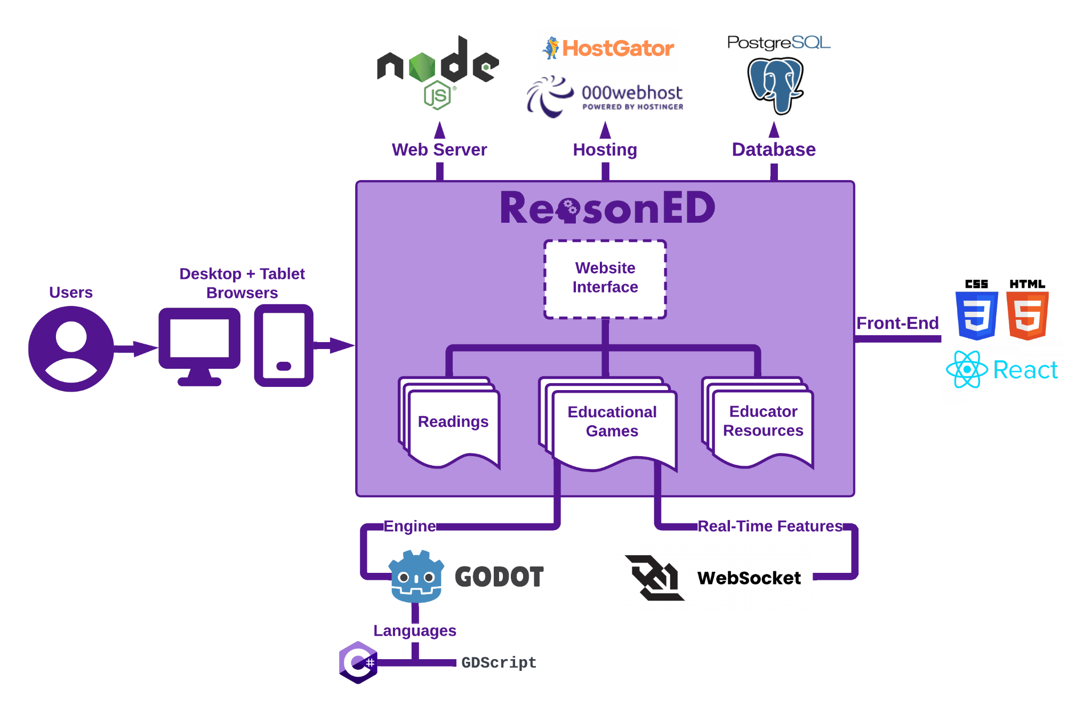
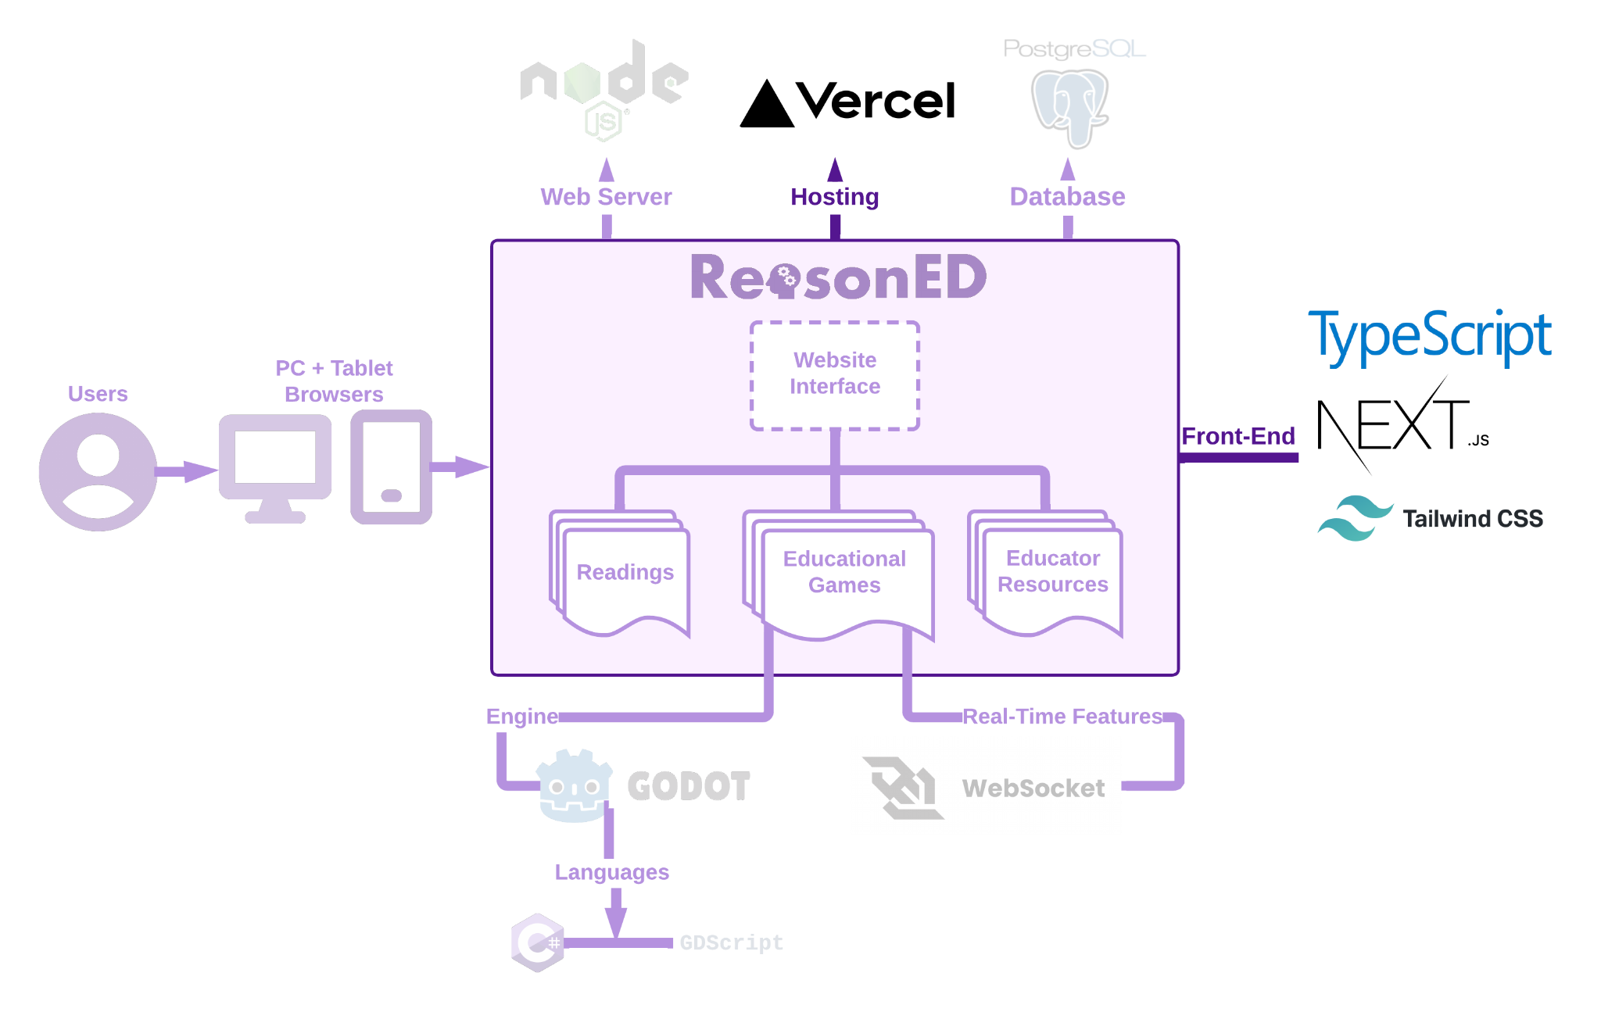
MFCD Changes
CS 411W
ReasonED | Formal Demo
Notes:
Explain what major functional components changed between 410 and now

Slide 6
Website
Changes
Planned | Actual
Account Creation and Login | ✓
Personal Profiles for Students and Teachers | ✓
Printable Graphics
Progress Tracking and Leaderboard
CS 411W
ReasonED | Formal Demo
Notes:
Explain the changes or additions of features that we made to the website itself.

Slide 7
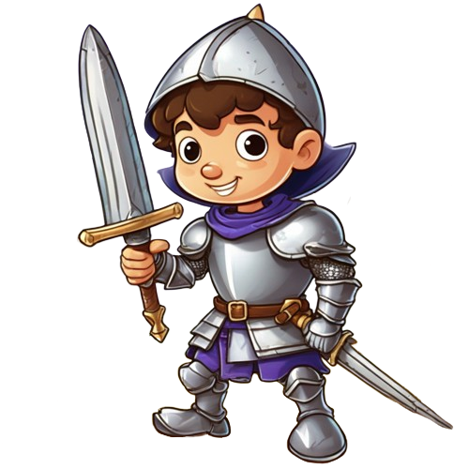
Straw Manny Changes
Planned | Actual
Player (Manny) can navigate training fields to find scattered knights and abilities | Knights scattered, abilities not. Players can move around freely.
Knights present random claims, player can choose from 3 responses for each | Knights present random claims, player can choose from 3 responses for each
Manny can attack Knight if a valid response is chosen, by clicking and using abilities | Players can click to basic attack and use 2 combat abilities to attack knights
Manny attacks strawman, lose 1 life if wrong answer selected | Manny attacks strawman, lose 1 life if wrong answer selected
Players progress to next level after 5 enemies defeated, lose if 3 lives lost | Progression not yet implemented - repeats level 1 for higher levels
CS 411W
ReasonED | Formal Demo
Notes:
Explain the changes or additions of features that we made to the design & development of straw manny

Slide 8
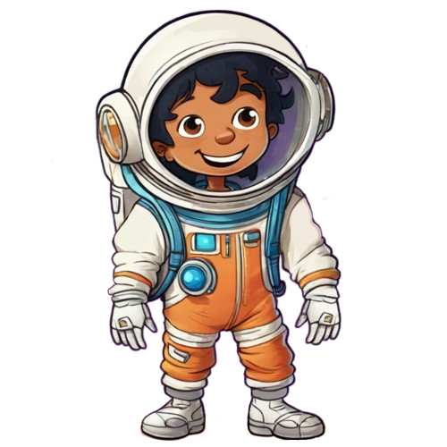
Hasty
Harry Changes
Planned | Actual
Player can navigate different planets to find scattered artifacts | Player can navigate three levels, currently there are no level transitions.
Players return to the spaceship once 6 artifacts are collected | Players return to the spaceship once 6 artifacts are collected
Harry types a report about the planet. Occasionally, he types a hasty generalization about a specific aspect of the planet. | N/A
Players must click a button indicating that the claim is a fallacy and choose the artifact from their backpack that disproves Harry’s claim | N/A
CS 411W
ReasonED | Formal Demo
Notes:
Explain the changes or additions of features that we made to the design & development of hasty harry

Slide 9
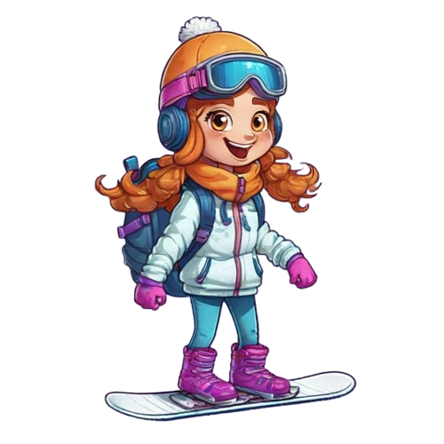
Slope
Sadie Changes
Planned | Actual
Auto-runner Platformer, players control Sadie | N/A
Sadie makes exaggerated claims or predictions that represent the slippery slope fallacy | N/A
Players presented with responses to choose from, only one addresses the fallacy | N/A
Select correct response before reaching a critical point on the slope. Choosing correctly helps Sadie continue down the slope, otherwise she slips and falls. | N/A
CS 411W
ReasonED | Formal Demo

Slide 10
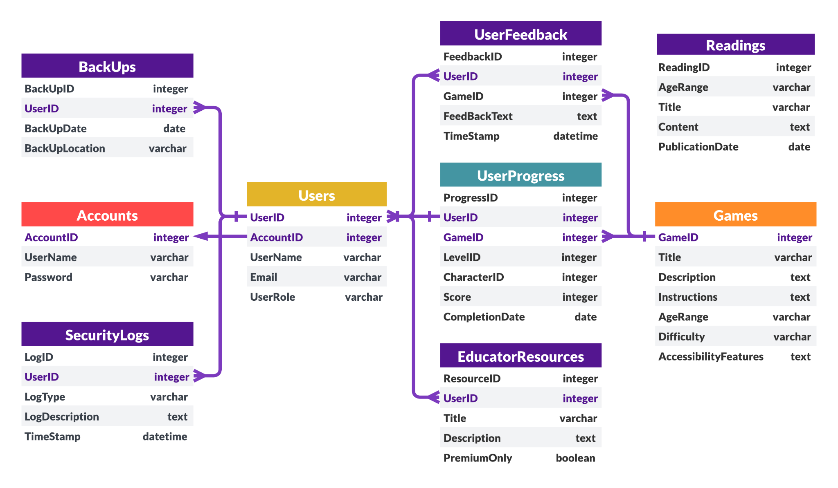
Database Changes
CS 411W
ReasonED | Formal Demo
Notes:
The image that you are looking at is the main database schema from CS 410, which highlights account management and security for our website.
We have made one modification by replacing the “Accounts” and “Users” tables with Students and Teachers tables. In the “Students”, we store information like email, username, password, and date of birth. On the other hand, the “Teachers” table contains data specific to teachers, such as their email and their area of expertise selection (including elementary, middle, high, and college levels. Both tables also have “reset token” and “verification code” columns to facilitate web interface tasks such as resetting passwords and verifying Two-Factor Authentication codes.

Slide 11
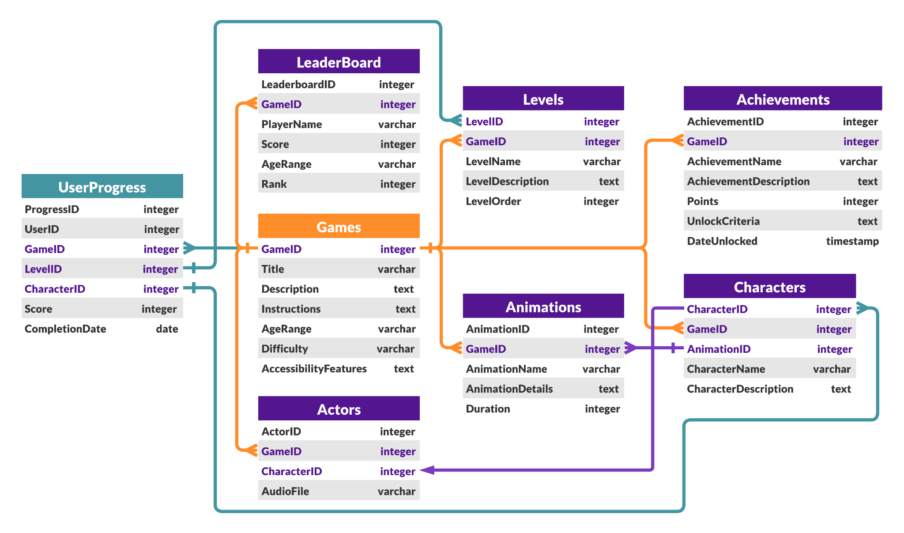
Database Changes
CS 411W
ReasonED | Formal Demo
Notes:
On this slide, we have the game database schema, which illustrates how the games interact with our database. This diagram remains unchanged since CS 410. It consists of everything from the games themselves to levels, animations, achievements, characters, and user progress, including leaderboards.

Slide 12
RWP vs. Prototype
Features & Functionality | RWP Features | Planned Prototype | Actual Prototype
PC & Tablet compatibility | ✓ | ✓ | PC
Account Creation | ✓ | ✓ | ✓
Accessibility Features | ✓ | Text-to-Speech | Text-to-Speech
Educator Tools | ✓ | Printable Graphics, Progress Tracking
Paid Features | ✓
Games for k-12+ | ✓ | 3 games, scaled for 3 general age groups | 2 partial games scaled for 2 different age groups
CS 411W
ReasonED | Formal Demo
Notes:
Fill out last column

Slide 13
Takeaways
Emily
Godot- Scripting
Godot- Scene, Node Structure
Debugging
Utilizing React
Utilizing Tailwind
API routes
Version Control familiarity
Animation
Alysha
Godot- Scripting
Utilizing React
Utilizing Tailwind
API Routes
Database Management
Debugging
Dakota
Godot- Scripting
Godot- Intended Workflow
Godot- Scene Management
Godot- Ui
Debugging
Sprite Art
CS 411W
ReasonED | Formal Demo
Notes:
Each member reads a column of their takeaways from the prototype development

Slide 14
Takeaways
Areeb
Utilizing React
Utilizing Tailwind
API Routes
Account Verification
Strong Security
Async Programming
UI Design
June
Godot Scripting
Godot Scene Structure
Godot UI
React
GitHub Wiki
Nolan
Godot Scenes
Godot Tilemapping
Godot Scripting
Game Content Creation
Debugging
CS 411W
ReasonED | Formal Demo
Notes:
Each member reads a column of their takeaways from the prototype development

Slide 15
Takeaways
Daniel
Godot Scripting
Godot Scene Design
Debugging
Version Control
UI Design
Async Programming
CS 411W
ReasonED | Formal Demo
Notes:
Each member reads a column of their takeaways from the prototype development

